Slide 1
Somethin’Ville
Group 6A
Kyle Sheridan
Steven Choma
Amy Kernutt

Slide 2
Kyle

Slide 3
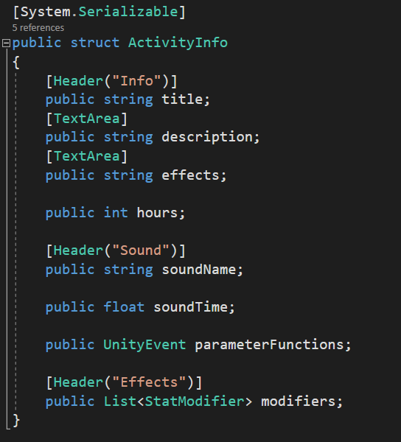
Activity system
System was set up to make implementation of sounds as simple as possible
Without sacrifice of control
ActivityInfo struct was created to store info on the activities
soundName for finding the appropriate event
soundTime to set the amount of time before the world sounds fade back in
Allows more flexibility on adding a quiet period at end of sound
parameterFunctions optional to allow functions to be called to set parameters etc.
Allows the changing of parameters on the events

Slide 4
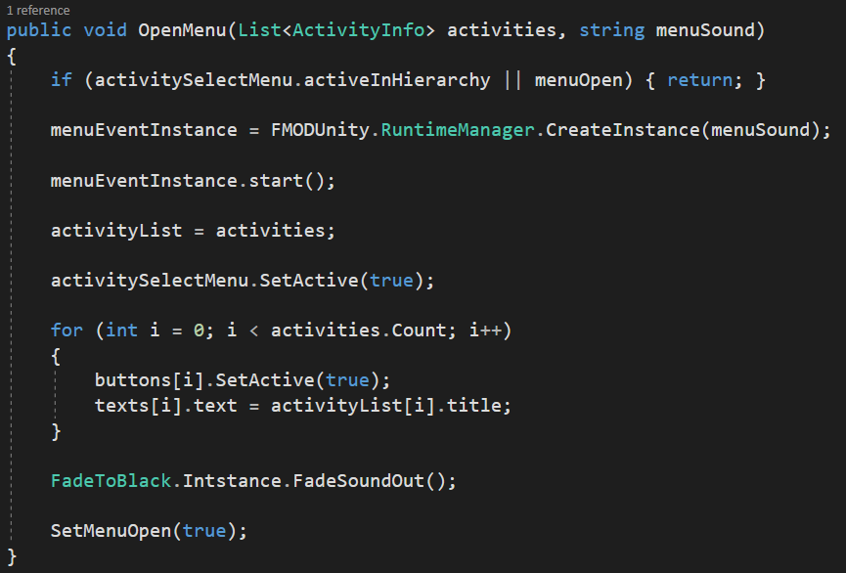
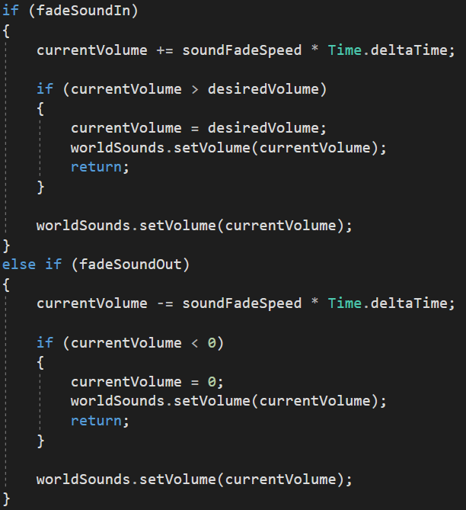
ActivityManager
Contains a list of available activities for each menu
As well as a reference to the current activity
And a FMOD event instance for its associated sounds
Also contains an event instance for the associated menu music
When the menu opens these values will be set
World sounds (FMOD bus) will fade out

Slide 5
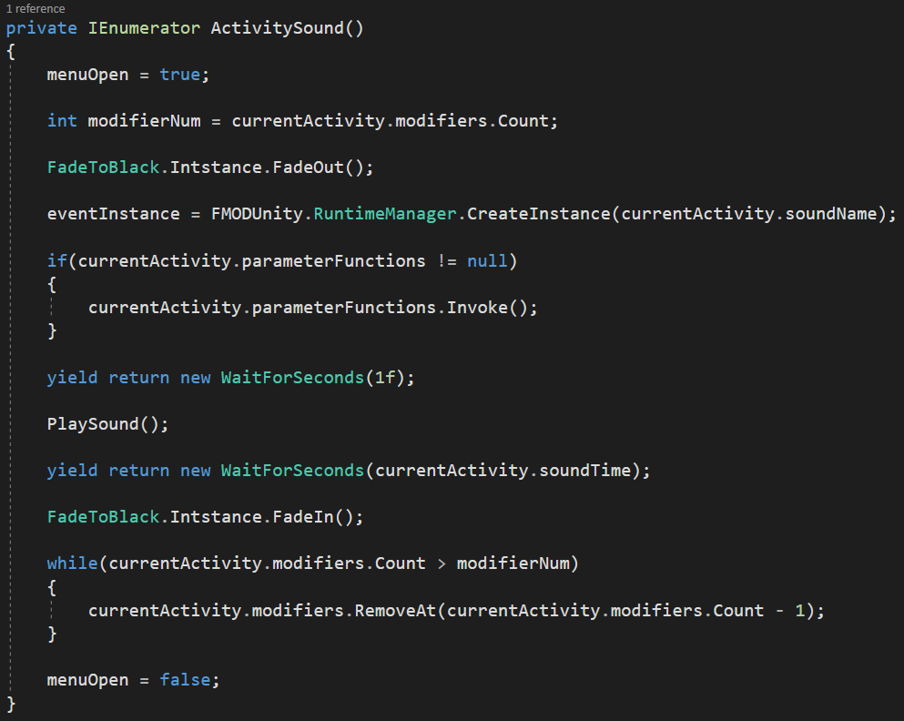
ActivityManager (Continued)
When the activity is accepted the menu music will stop with STOP_MODE being set to allow fade out
a coroutine is then started that will play the sounds
The event instance is created based on the activity’s sound name
All of the parameter function will be called
Then the sound will be played after a short delay to allow the music to finish fading
The function then waits until the end of the sound before fading world sound back in

Slide 6
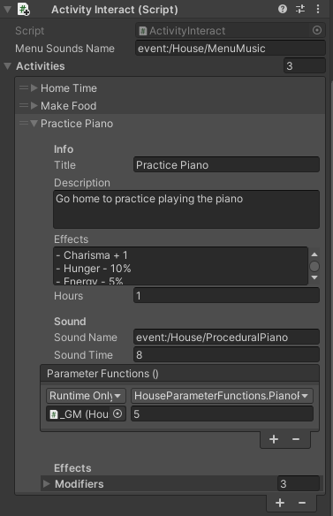
ActivityInteract
A script was created to be placed on the icons
Creates an instance of the menu / activities
Makes creating new menu / activities simple

Slide 7
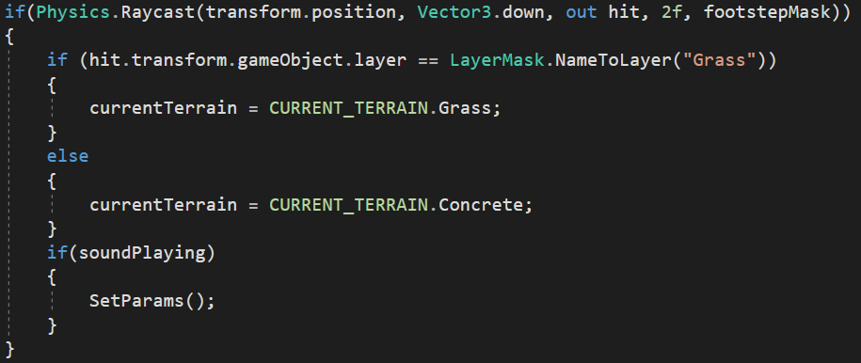
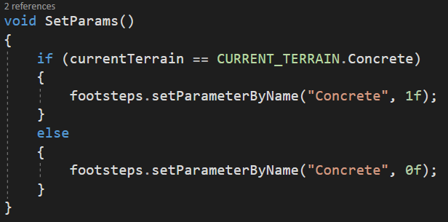
Footstep Implementation
As the game is first person and therefore has no animations
The audio plays based on the players speed
A raycast is created that will check the ground directly below the player
If the collider was a “Grass” layer then the type of sound would be set to grass
Otherwise it would be set to concrete
The footstep FMOD event was created by Gerald

Slide 8
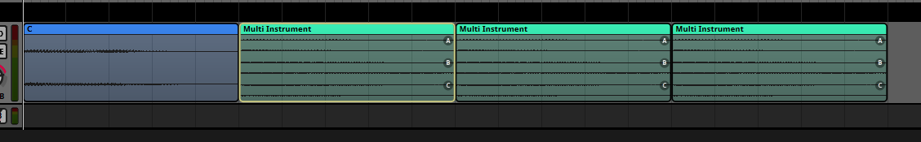
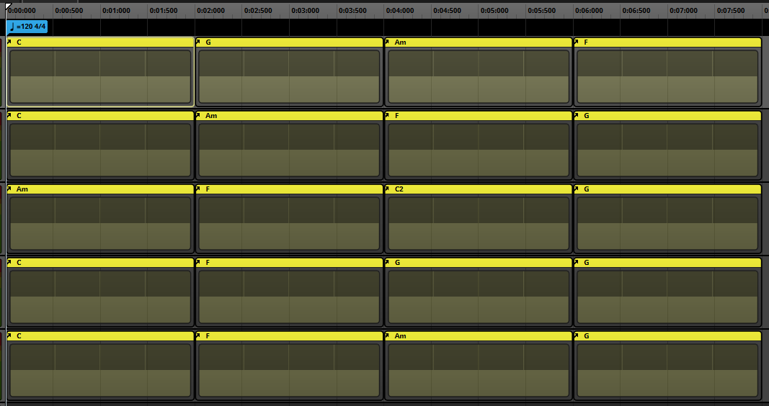
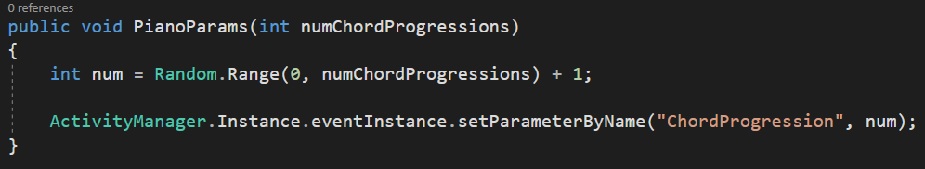
Procedural Piano (Sort of)
One of the activities I created for the house was practice the piano
I didn’t want this to be the same piano loop played every time
This works by having an asset for each note in the C major scale (from C - C octave)
Assets were exported from FL Studio
Nested events were created for each of the main chords in the scale - I IV V iv
The event would start with the root of the chord
The next 3 notes will be a random note from the chord
Using a Multi Instrument (shuffle)
4 bars were created from common pop chord progressions
Finally a parameter was created for the chord progression (5 were used)

Slide 9
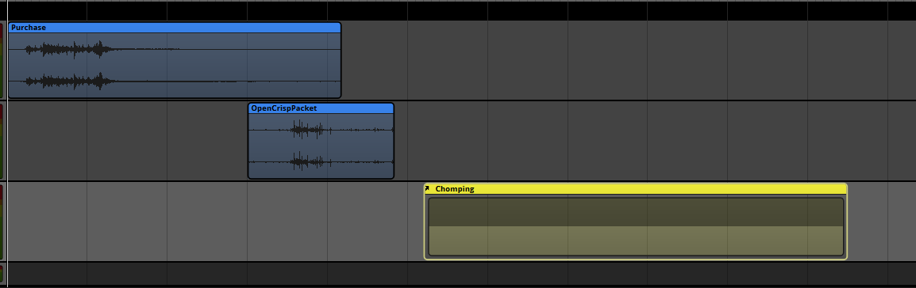
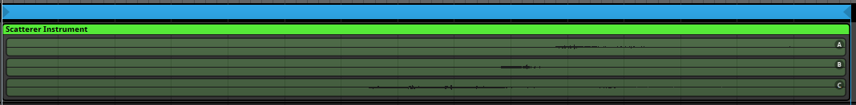
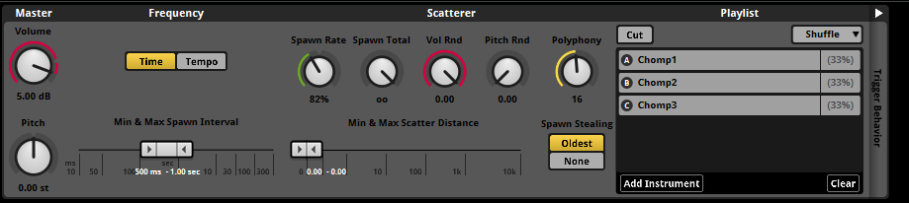
Shop Buy food
For most of the activities in the shop, the sound starts with a cash register
For eating food a open packet sound is played that has a large random deviation on both pitch and volume
This was done for many other sounds across my activities
A nested event was created for the ‘chomping’
It consisted of a looping scatter instrument with 3 different chomp sounds
Each sound starts with a short quiet period
A random offset is applied to sound to give a random timing to chomps

Slide 10
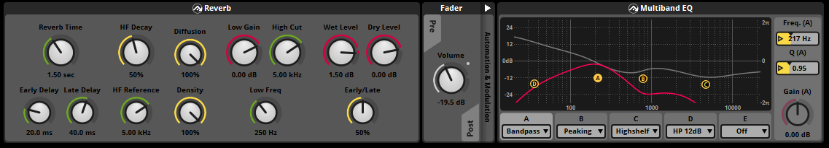
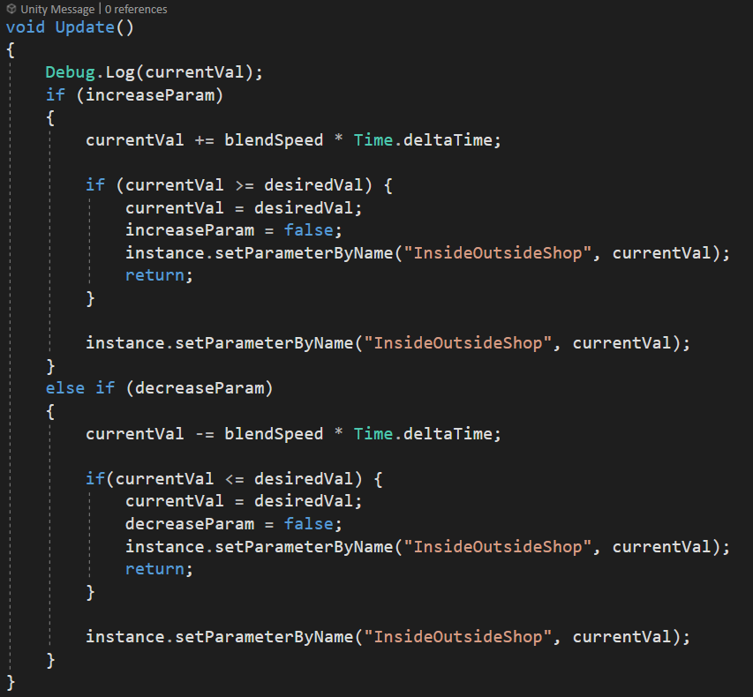
Shop ambience
The shop ambience is a 3D sound for the world ambience of the shop
There are 2 tracks of the same song looping at the same time
One has more reverb, an EQ and some distortion to give a different room sound
Other only has a small amount of reverb to simulate being inside the room
A parameter, and volume automation is used to blend between these 2 tracks
Colliders were used in unity to blend the parameter to the desired value

Slide 11
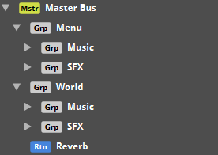
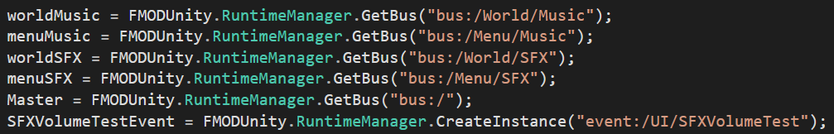
Audio settings
FMOD busses were created to be able to affect groups of sounds within game.
Sliders were used to easily change these values in game.

Slide 12
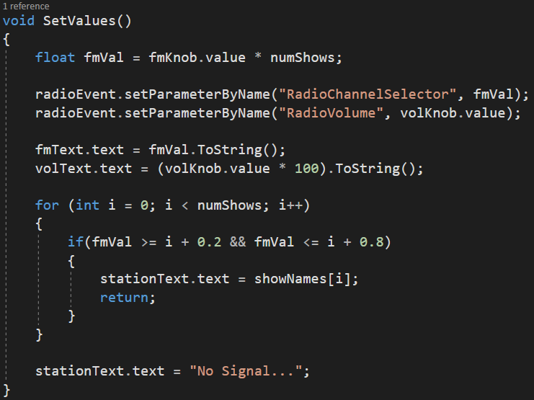
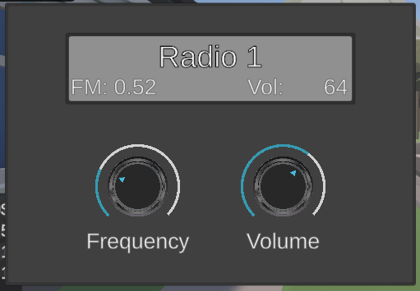
Radio UI
UI was created to edit the parameters of the radio
The event parameters are then set to the values of the UI

Slide 13
Steve

Slide 14
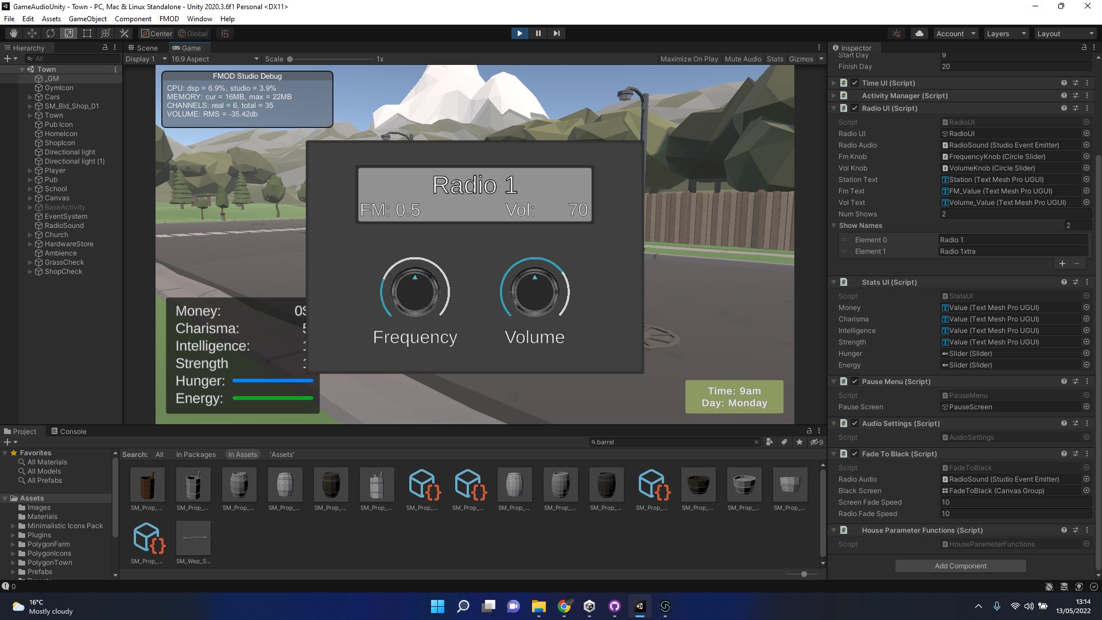
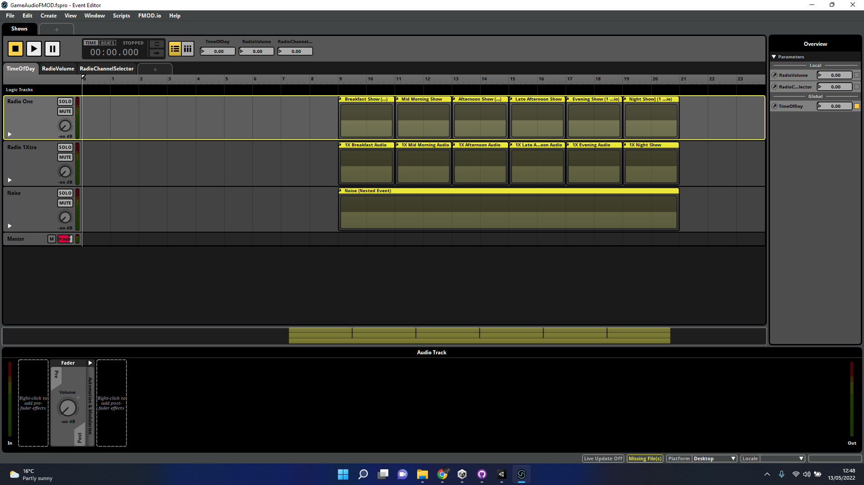
Radio - Soundtrack
Multiple stations covering a diverse range of BBC Radio Channels (0900-2100)
ERA License BCU
Radio show times are controlled with the in-game global time of day parameter
Noise is used to simulate static when changing stations
Limitations on upload due to Github data limitations
Mono, 128mbps, MP3, 15 minute versions were used for shared work
Stereo, 320mbps, MP3, 30 minute versions used for presentation.
Radio GUI - Design and development by Kyle Sheridan

Slide 15
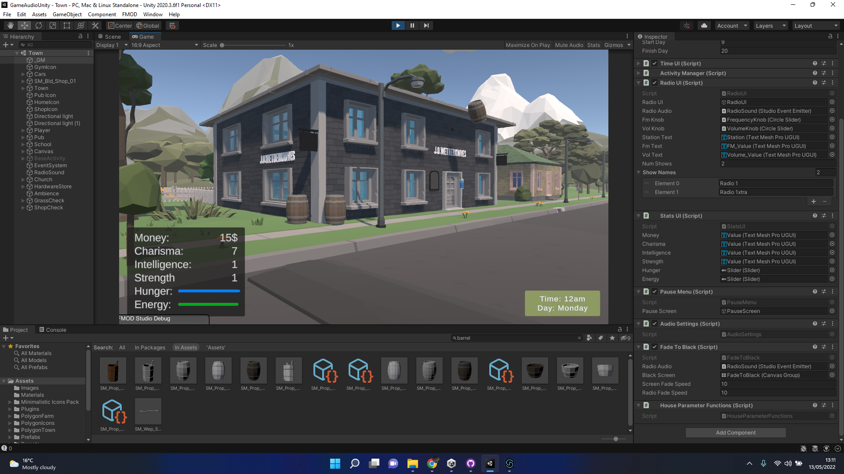
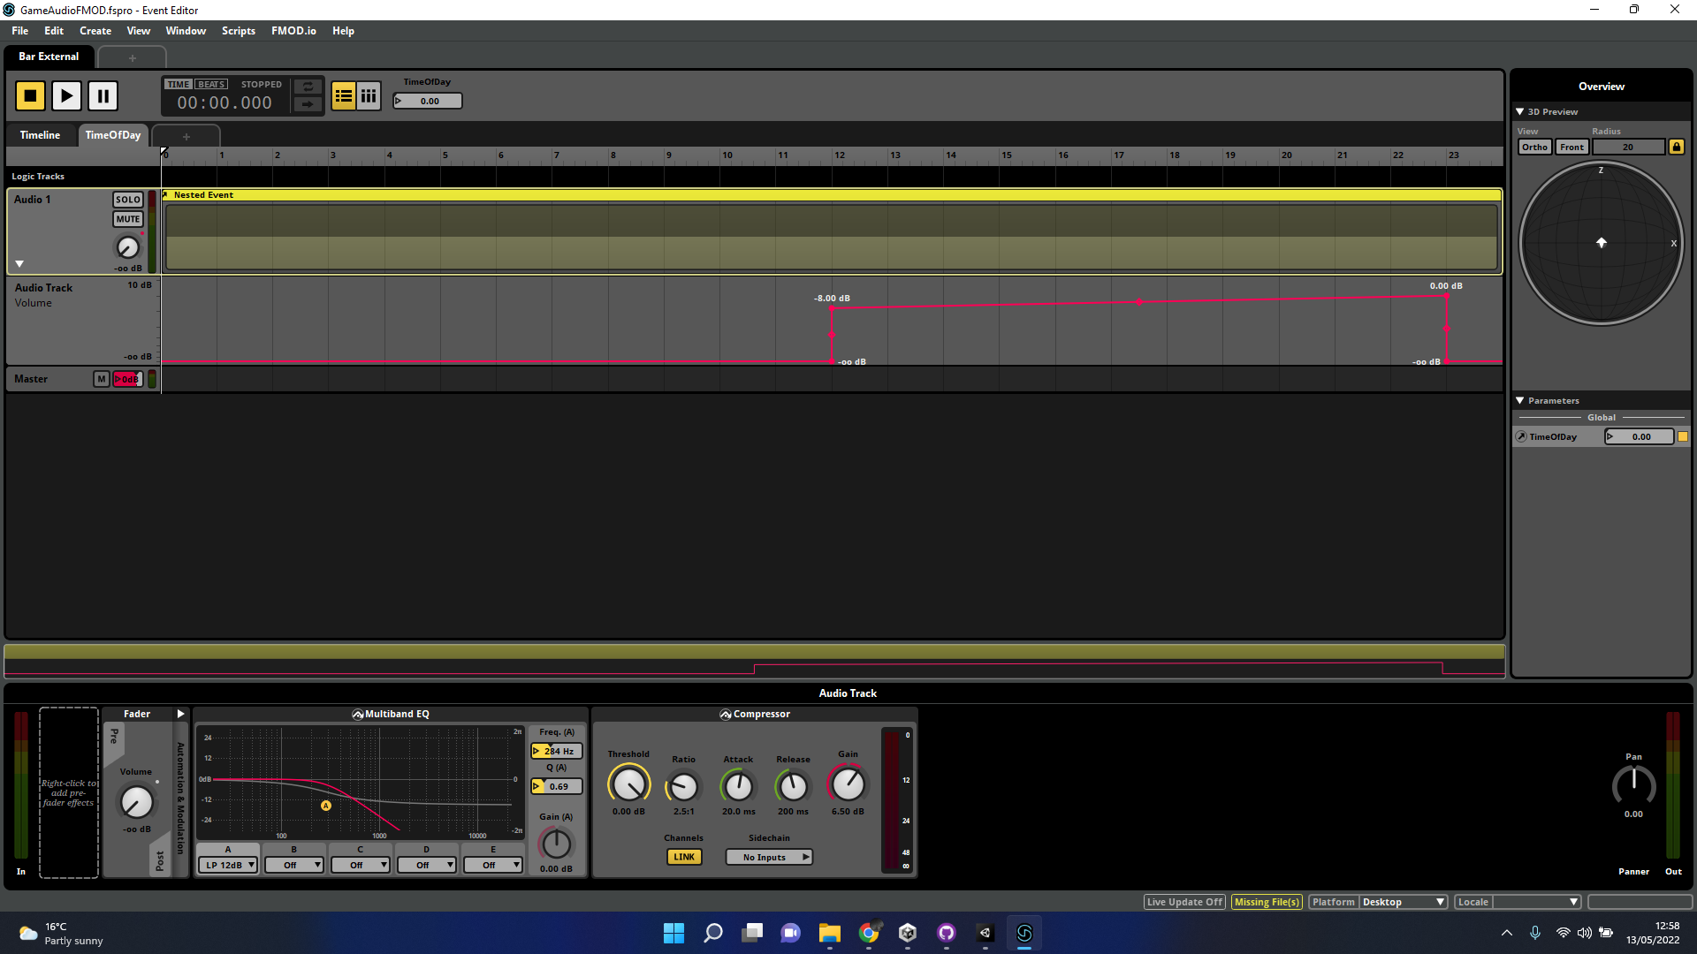
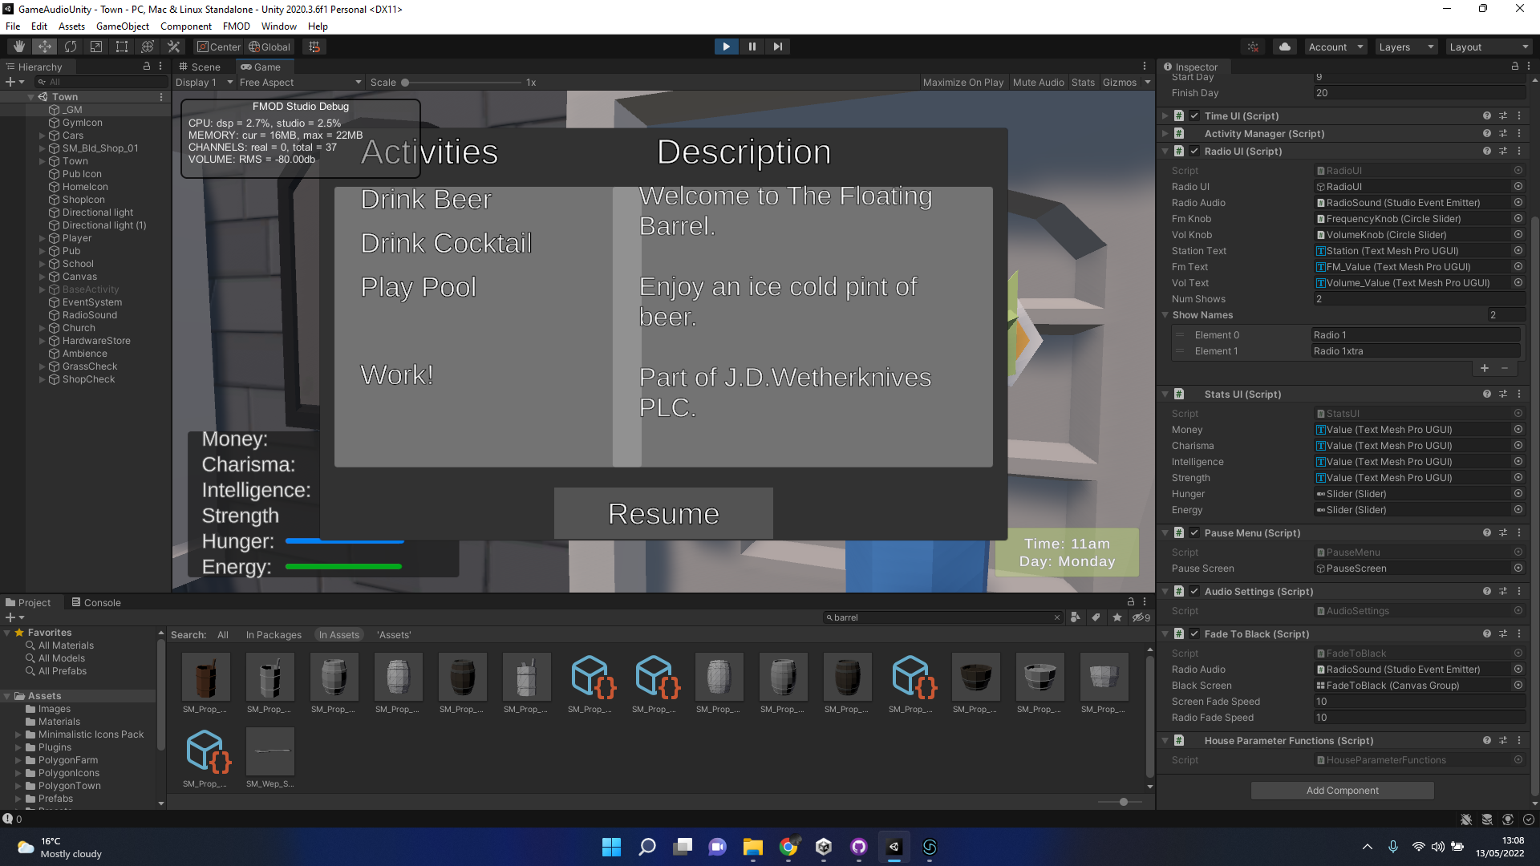
Building 1 - The Floatin’ Barrel
External audio is a filtered version of the internal
Utilises the ToD parameter to increase from 1200 until 2300 in-game time.
Relevant sound options for the in-game options

Slide 16
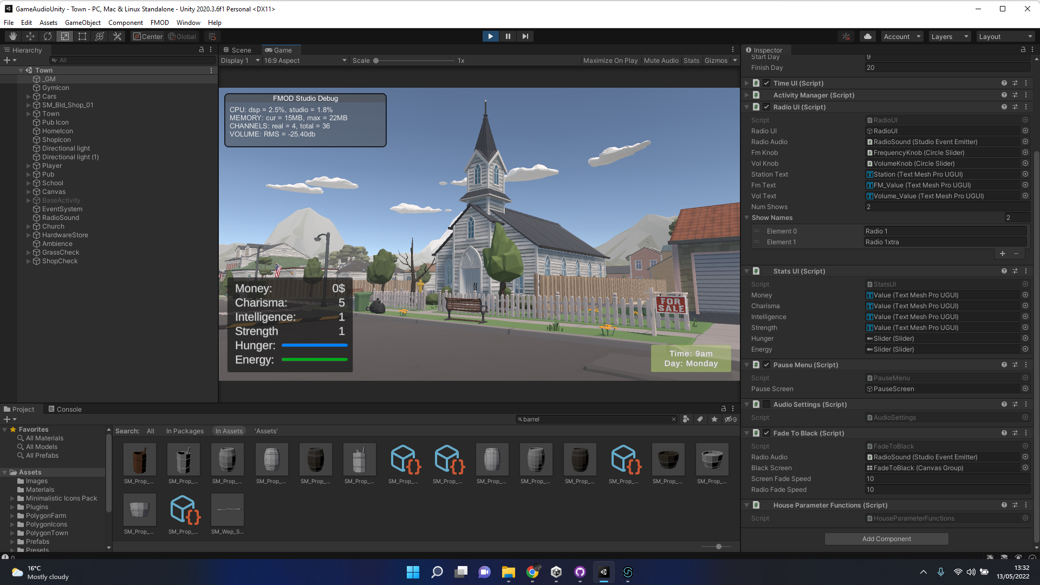
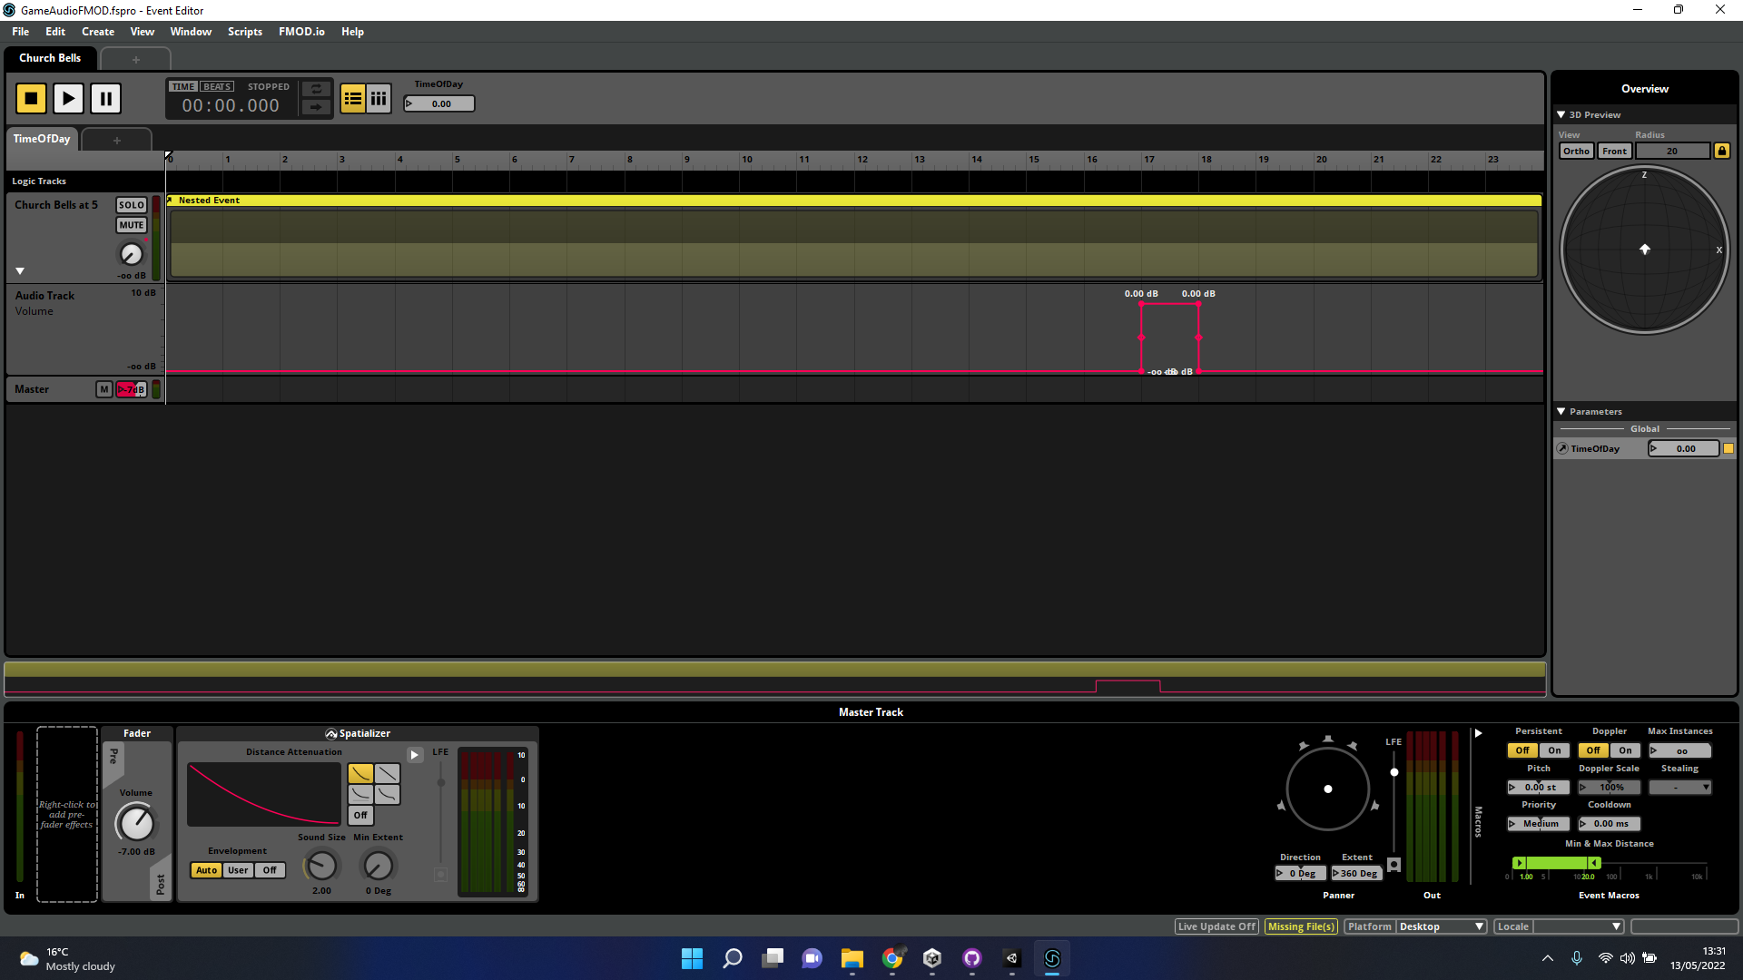
Building 2 - Wholly Holy Church
2 Significant times when it comes to the church
1700-1800 (Daily) - Bells ring throughout town
1800-1900 (Daily) - Service/Sermon
Can be heard from a close distance outside
Two different services
Intensity of Ambience of church works on similar system as The Pub
Increases through the day.

Slide 17
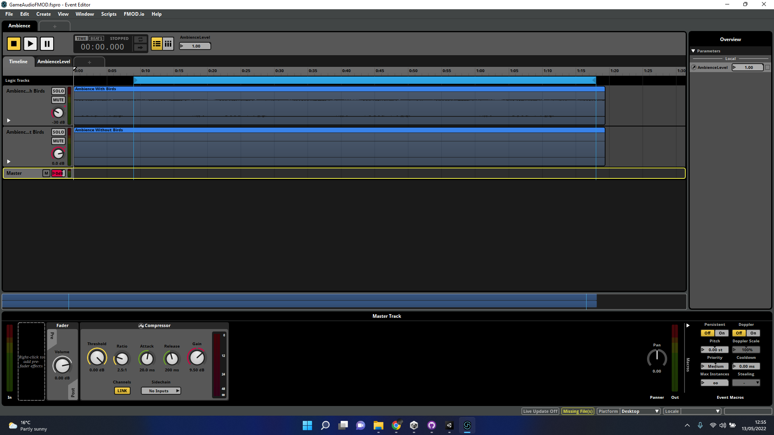
Ambience
Wind and Birds Tweeting
Subtle
Volume in main preferences
Mix of noise captured from

Slide 18
Amy

Slide 19
Process
Explored the game for potential sound ideas
Collected audio through online databases and live recordings
Processed audio using Reaper
FMOD implementation and sound design
Unity Implementation

Slide 20
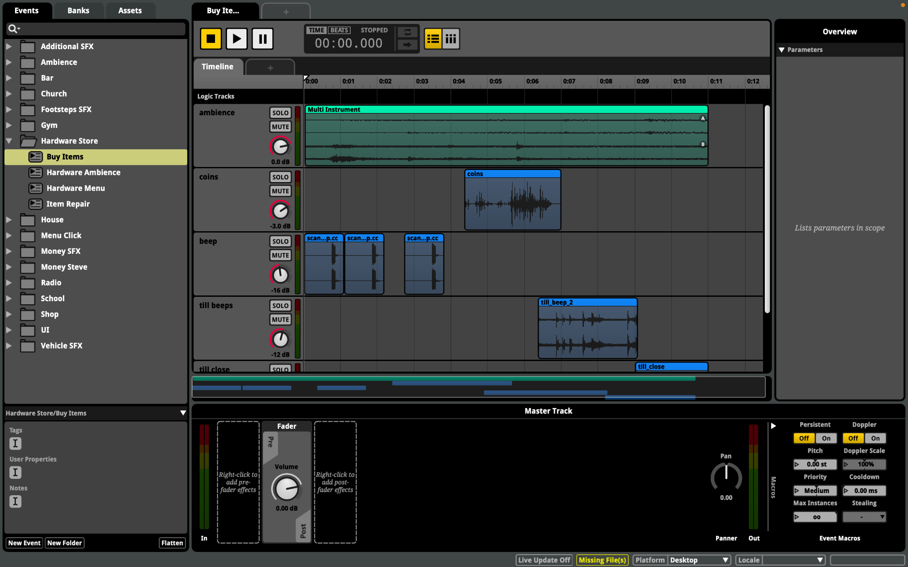
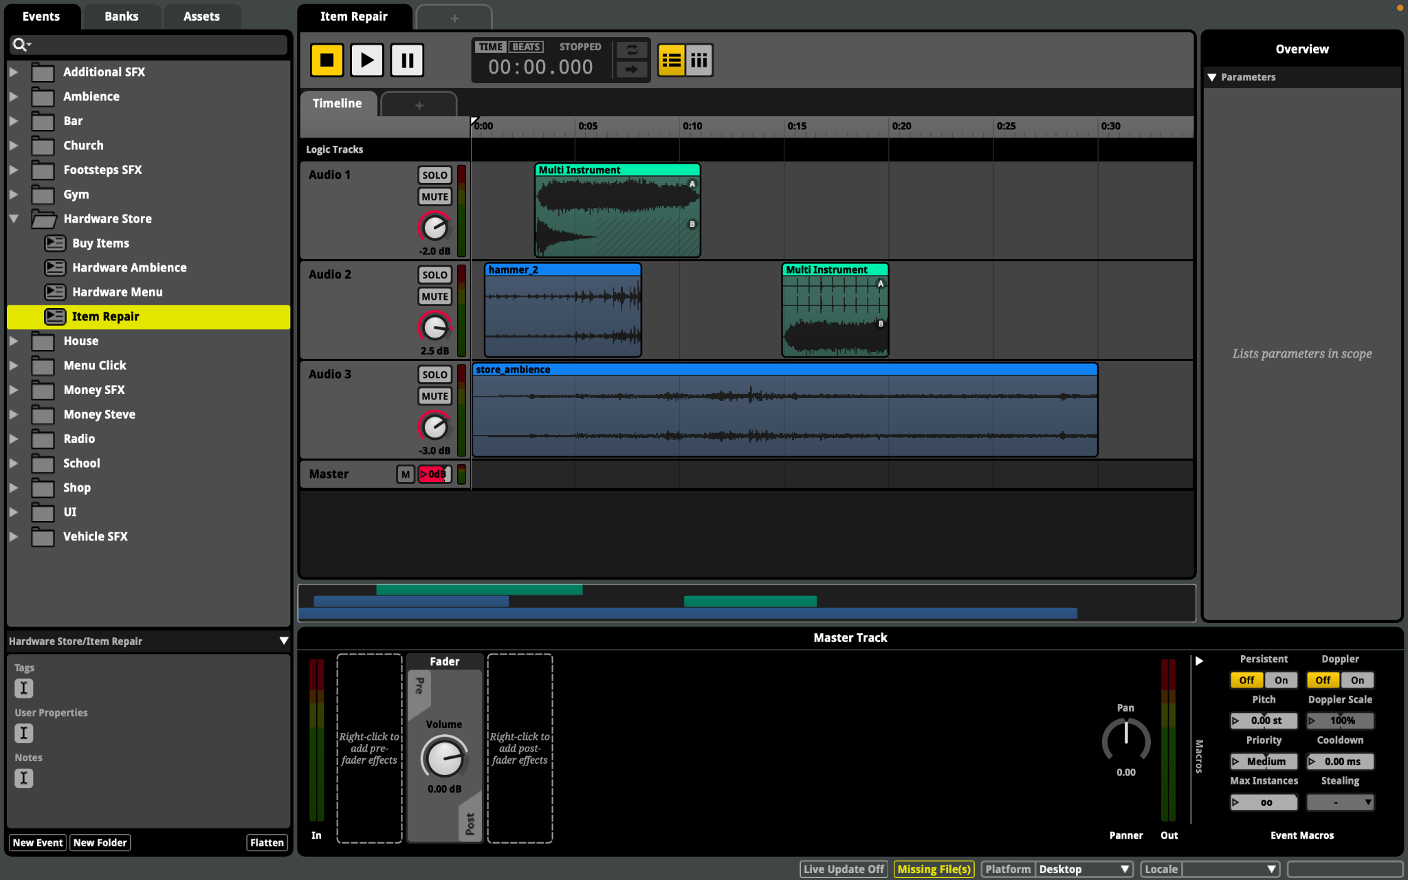
Hardware Store Activity Menu
Menu music involved layering multiple SFX
Buy Items
Till beeping and closing, trolleys, shop ambience, coins rattling
Item Repair
Power tools, hammers, bangs, shop ambience
Multi-Instrument events
Audio layering

Slide 21
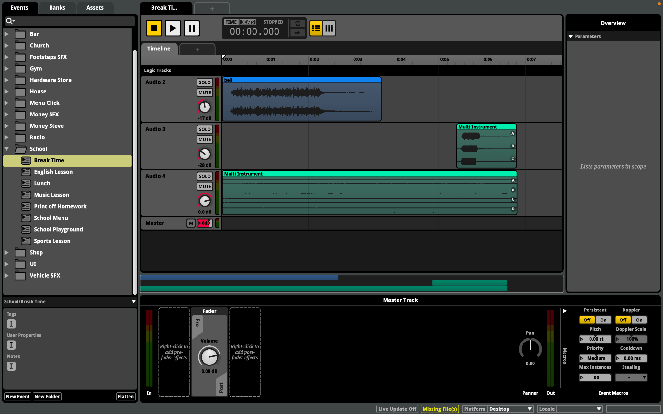
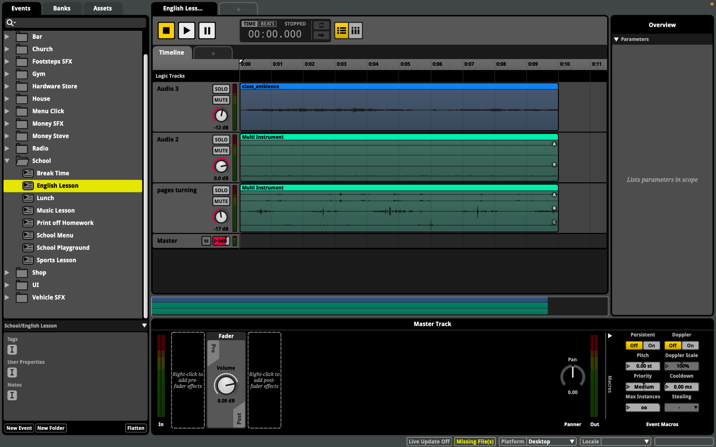
School Activity Menu
Activities: English lesson, music lesson, breaktime, sports lesson, lunch, print off homework
Break Time
Alternate whistle pitches
Different playground ambiences
English Lesson
Variation of recorded page turning sounds
Variation of writing recordings
Sports Lesson
Alternate between basketball and football
Different pitches of whistle

Slide 22
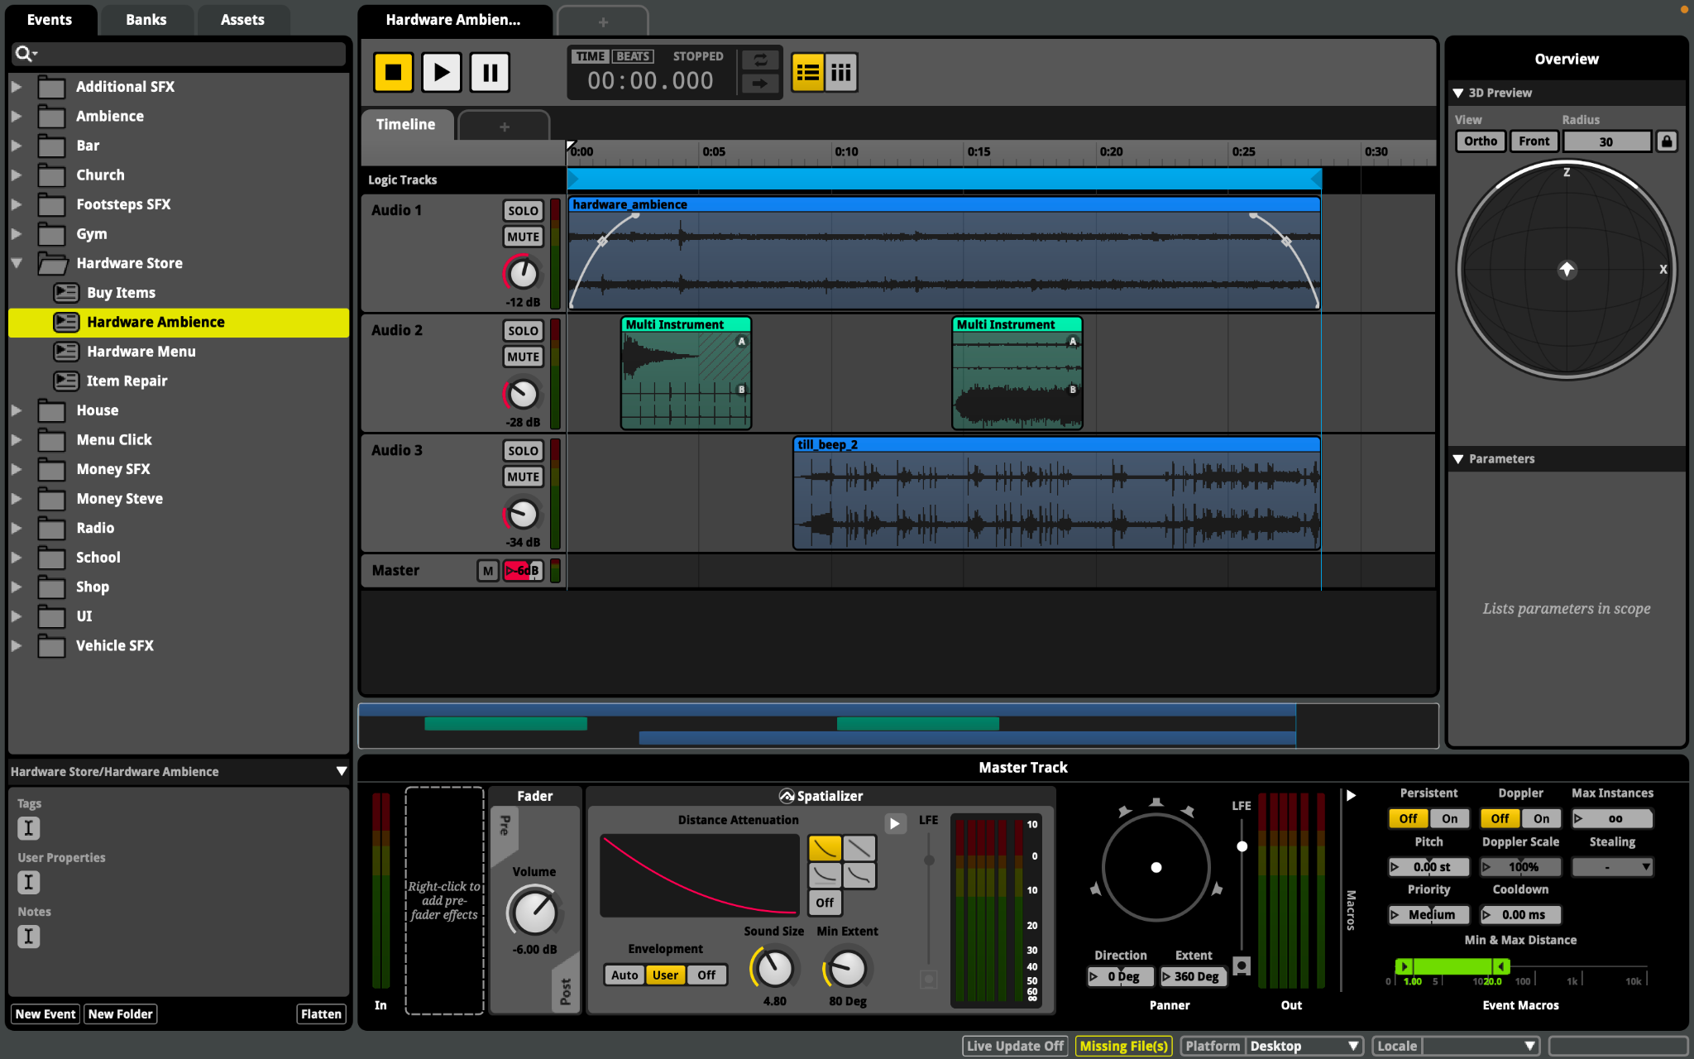
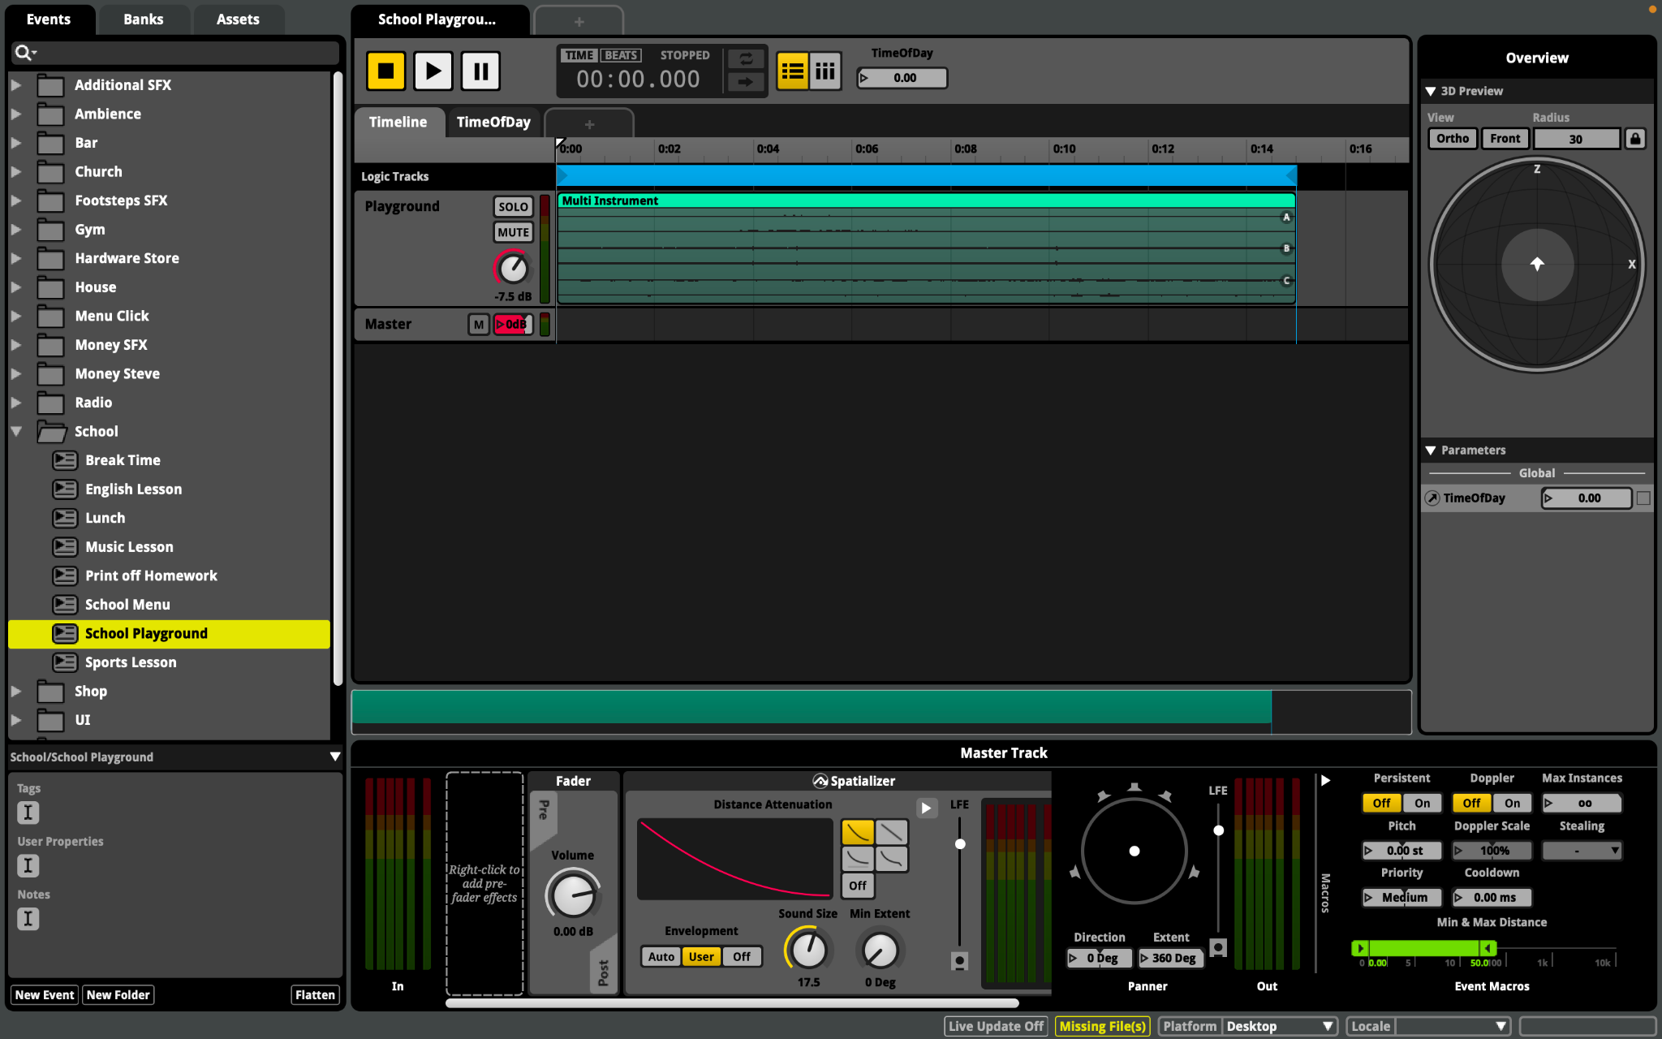
Ambiences
Hardware Store
3D timeline
Audio Spatializer
Multi-instrument events
Power tools, hammering, bangs, till beeps
School
3D timeline
Audio Spatializer
Multi-instrument events
Alternation between school playground ambiences

Slide 23
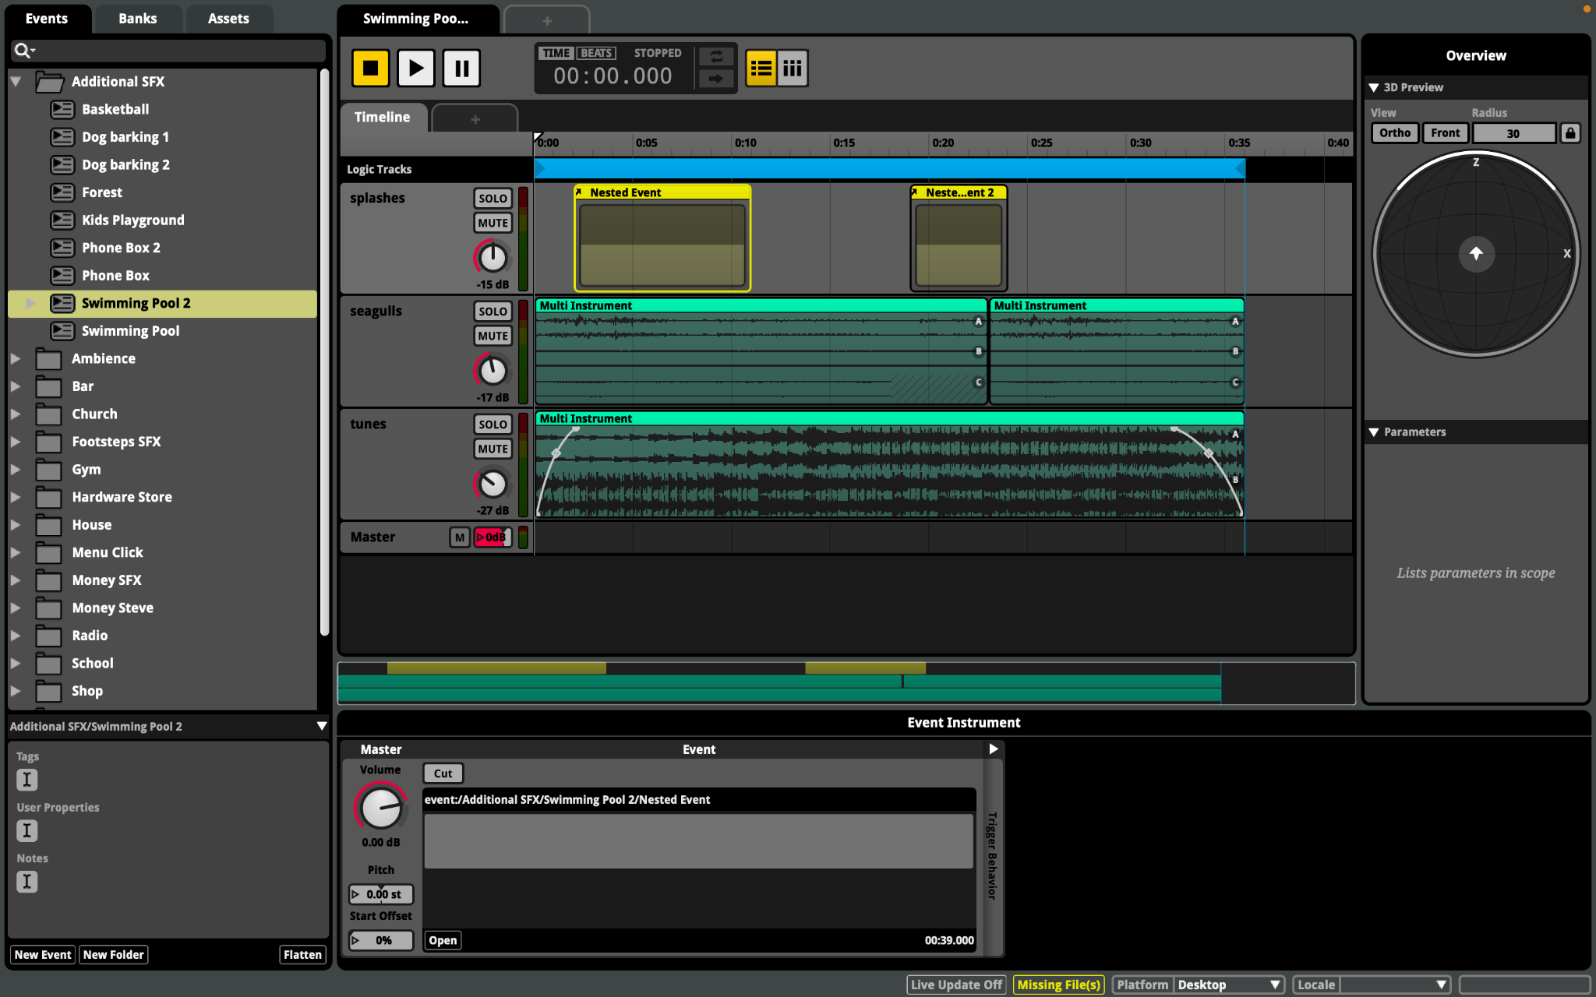
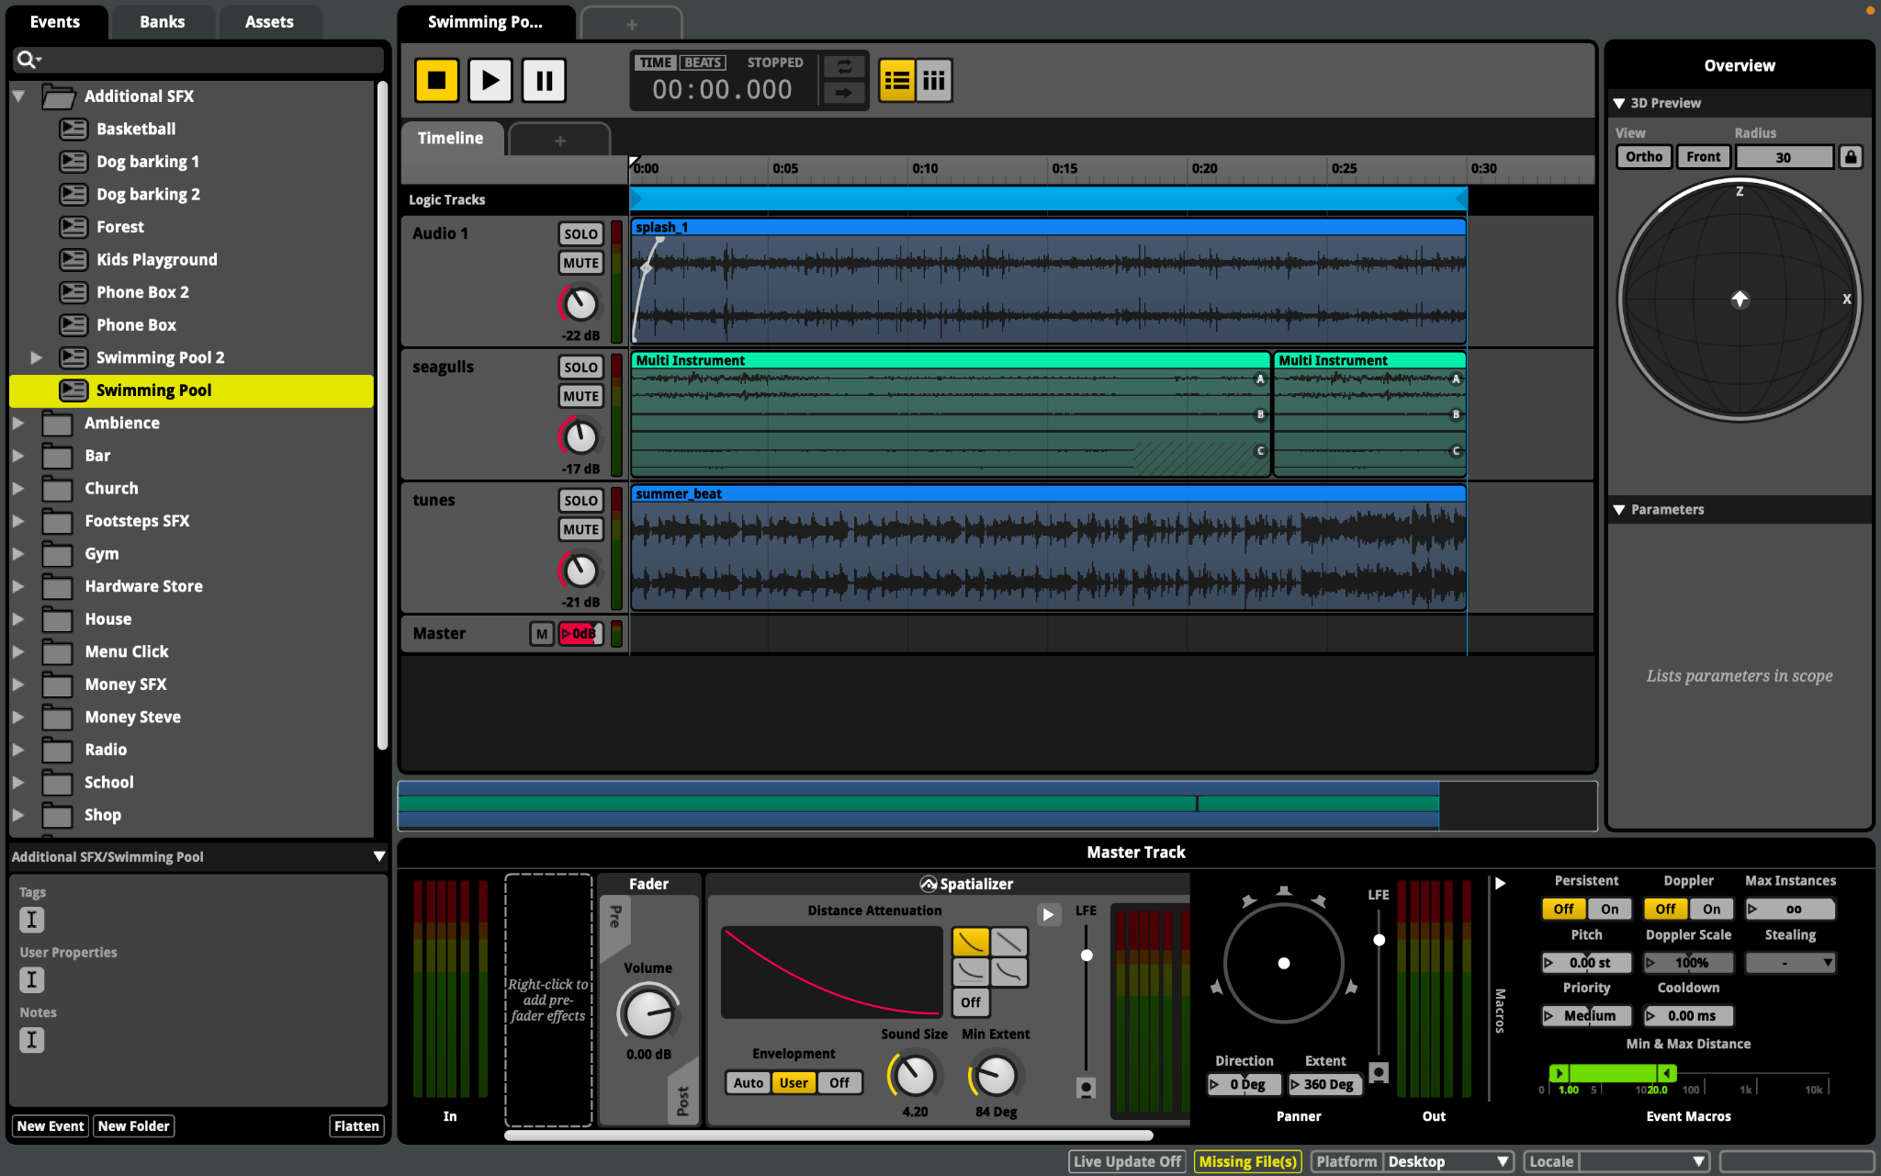
Additional Ambiences
Swimming Pools
Nested events triggering splashes
Variation of seagull noises
Alternate between summer songs
Phone Box
3 different styles of ringtone
Voicemail service (not implemented)
Kids Playset
Circus/kids background music
Faint swingset squeaks
Children playing and shouting ambience

Slide 24
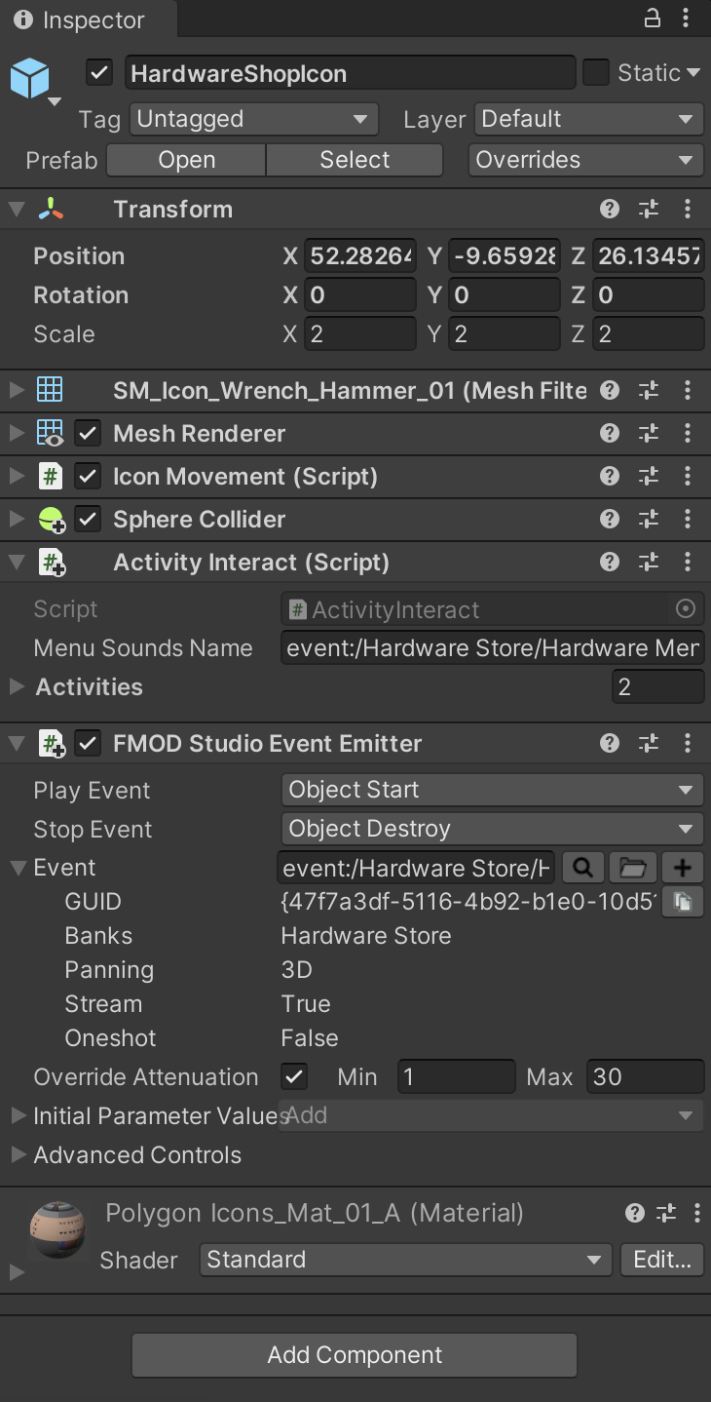
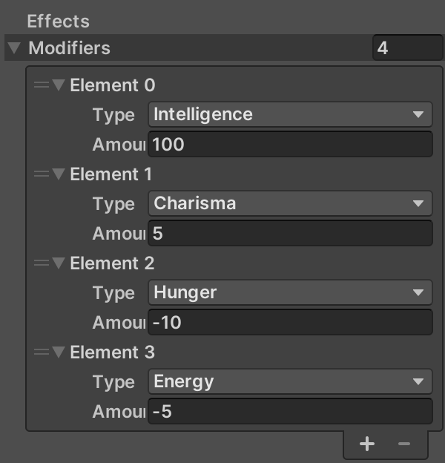
Unity Implementation
Activity Menus
Activity Interact
Assigned FMOD event to activities and menu music
Adjusted statistic changes
Ambiences
FMOD Studio Event Emitter
Assign 3D events
Event conditions
Override attenuation

Slide 25
Gerald

Slide 26
Contributions
Gym Activities - Weightlifting, Boxing Session, Fitness Class, Treadmill
Vehicles - Moving and stationary (Unity Implementation: Kyle Sheridan)
Footsteps (Unity Implementation: Kyle Sheridan)
Some of the Extra Environmental sounds - Dog Barking, Kids playing basketball

Slide 27
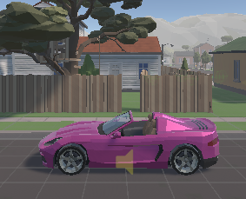
Moving Vehicles
There were two things I had to consider:
How to implement Doppler effect for the Vehicle's’ engine
How to produce the sound of the wind when vehicles’ drive by

Slide 28
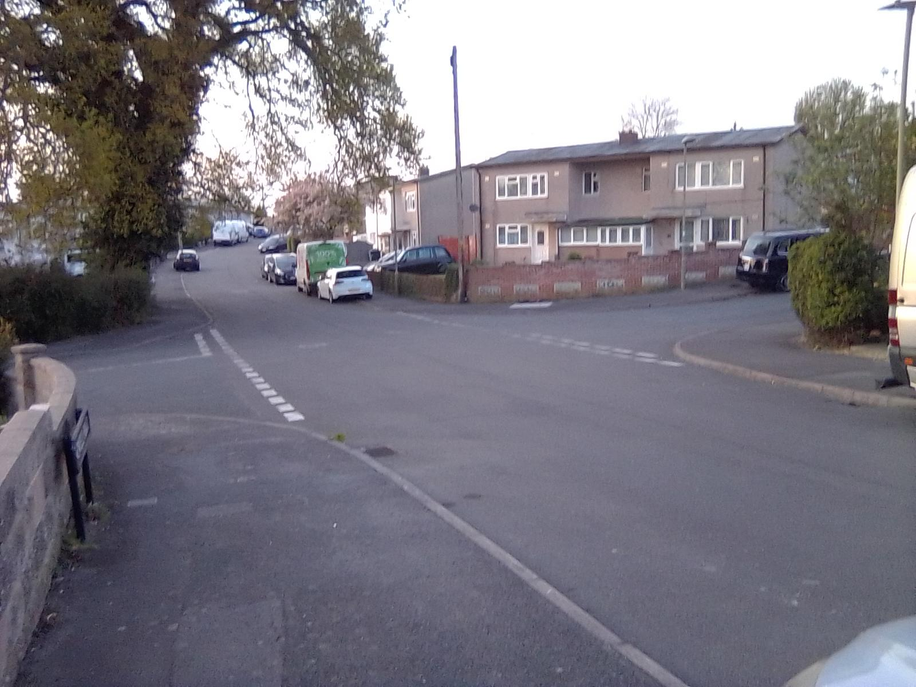
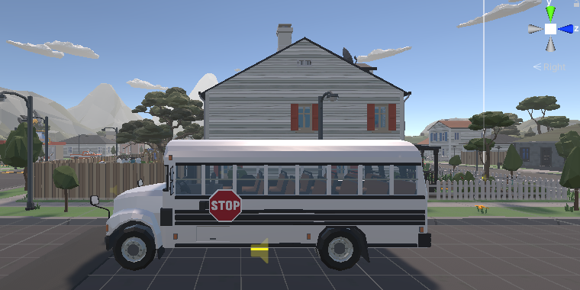
Vehicles - Process
Audio recordings of car driving by was initially going to be implemented for the moving car in the game. This wasn’t the best method because the audio recordings would have to match the speed of the vehicles.
Instead, Loops were created using different vehicle engine and wind sounds . A parameter was created to change the pitch of the engine as the vehicle drives passed the player.
Vehicles’ doppler effect was implemented by Kyle Sheridan

Slide 29
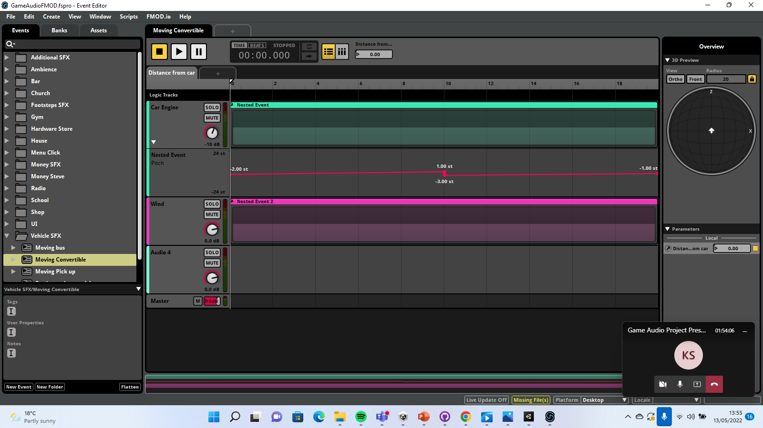
FMOD event - Vehicles

Slide 30
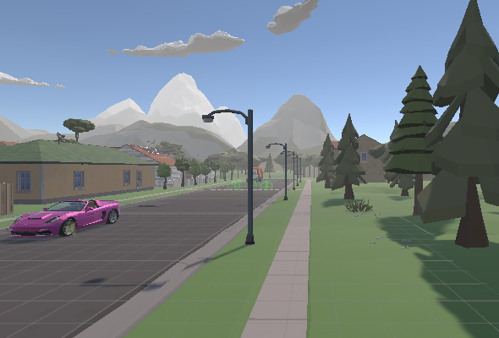
Footsteps
The game has two main types of surfaces: Concrete and Grass
To implement two different footstep sounds for these two surfaces, a parameter was created to switch between the surface footstep sounds
Initially, a simple loop was used for both of the sounds, but a multi instrument was used instead. This enabled me to randomise each footstep that plays and the pitch that it plays at. This made the footstep sounds feel more realistic when they were implemented.
Footsteps were implemented Kyle Sheridan

Slide 31
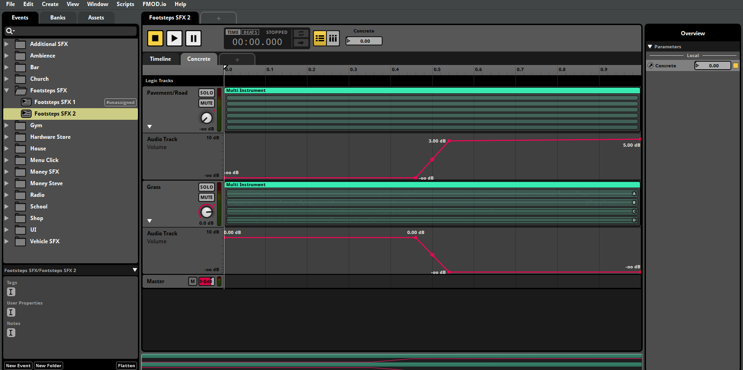
FMOD event - Footsteps

Slide 32
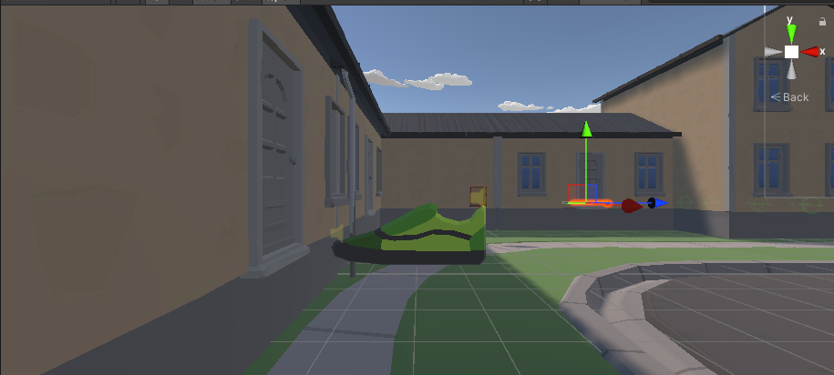
Gym Building and Activity sounds
Initially, only a weight lifting sound was going to be implemented.
To improve upon this, more gym activities and background sounds were added to sonically capture the gym environment
Gym ambience is played when the gym menu appears

Slide 33
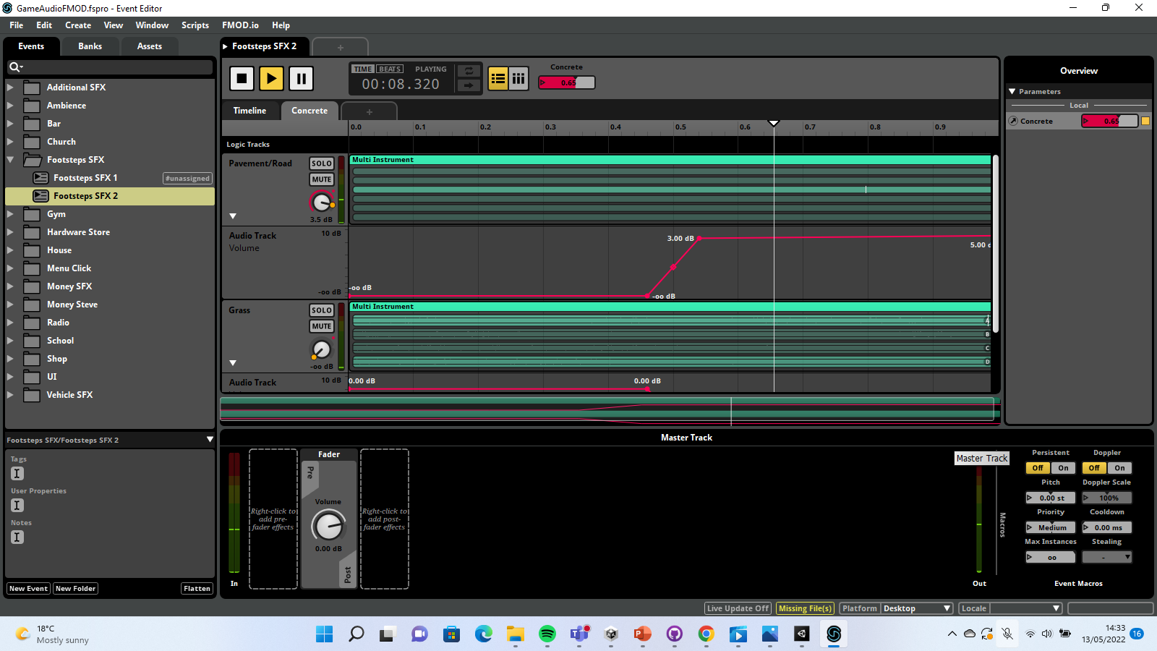
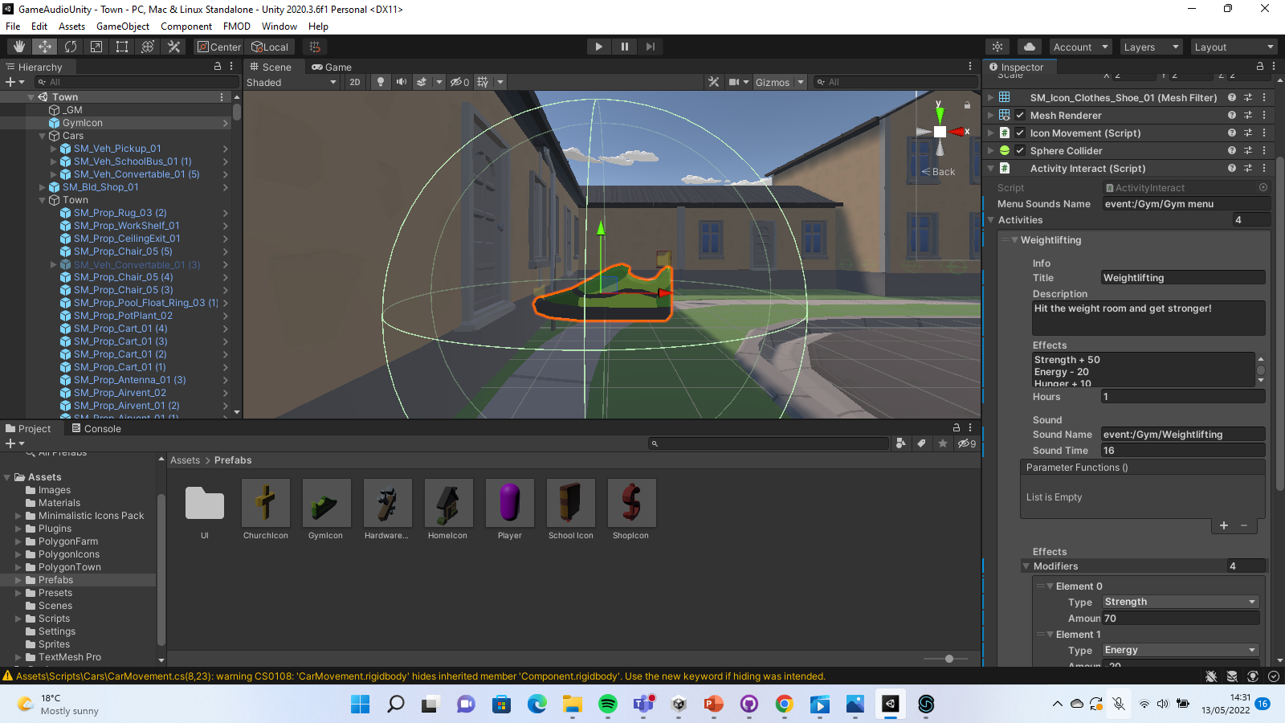
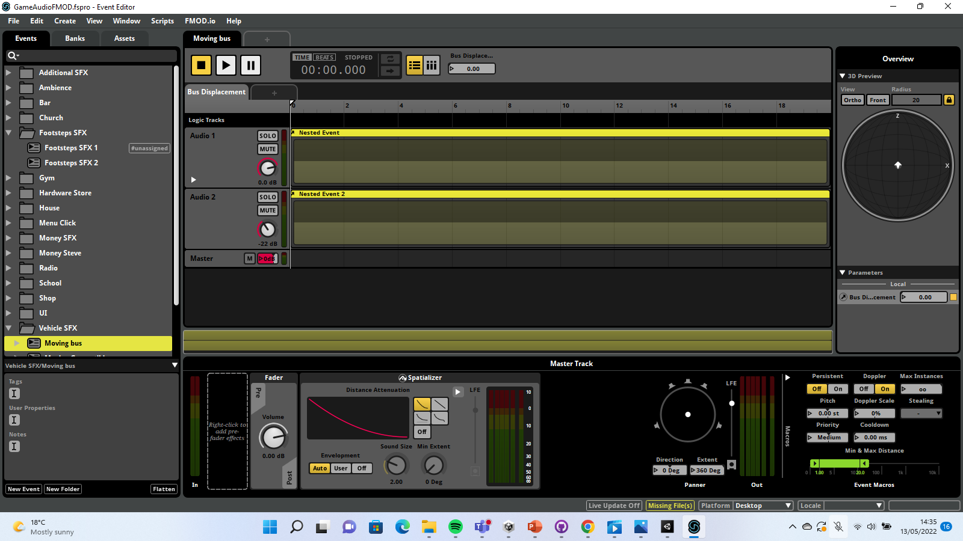
Unity implementation
Vehicle and environmental sounds were assigned were assigned to 3D events. The radius of the events were changed to fit the environment
Gym menu sounds were assigned to the gym icon, where multiple activities were created.
Footstep sounds were assigned to 2D events and were changed from stereo to mono

